Slide 1
Dhruvi Patel
C0719320
Quiz India (iOS Application)

Slide 2
Quiz about India
It is the second most populous country in the entire world and one of the biggest on the globe. With some of the oldest civilizations in the world, some of the most diverse cultures and wildlife in the world, India is a place that you could spend an entire life exploring and you would still have one third of it to see.
So why not take a minute and try out this quiz that we have prepared for you on one of the greatest nations? What is the approximate population of India? India was part of what country’s great empire until the 20th century? In how many wars with its neighbor, Pakistan, has India been involved? Indian food will also be among the topics - so try it out!

Slide 3
Flow of Quiz
Introduction
Quiz Score
LogIn
Play Quiz
LogOut
All Score

Slide 4
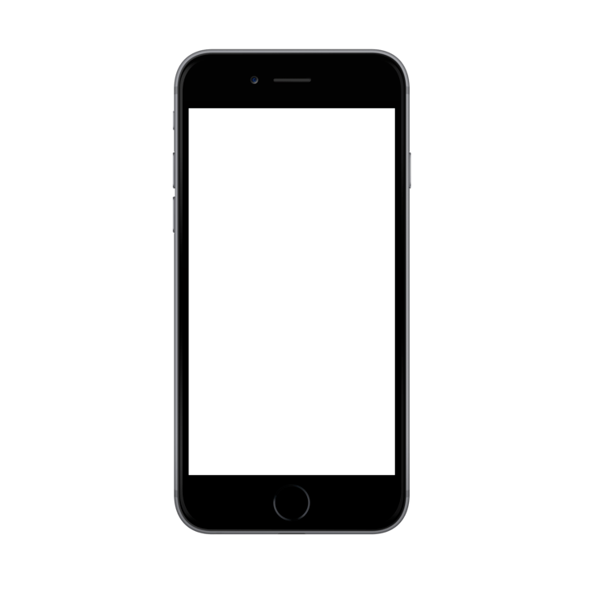
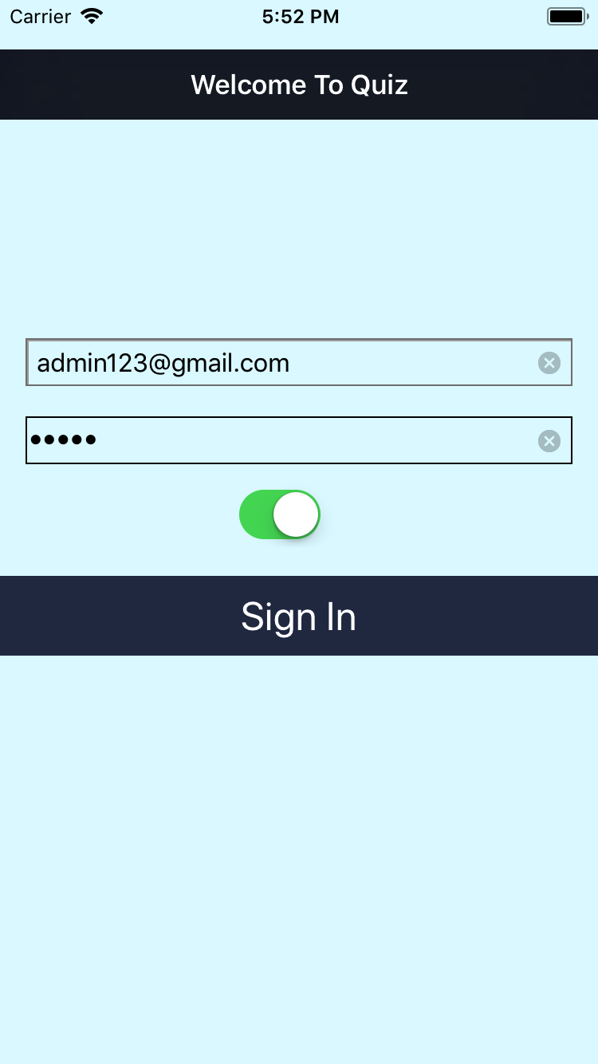

Quiz about India
Login to quiz to save your score.
Auto Login functionality in the application.
Launcher Screen
User Default
Plist
NavigationBar
Text to Speech
AlterView
Switch
Timer
Progressbar
Customized radio button
WebView
Table View

Slide 5
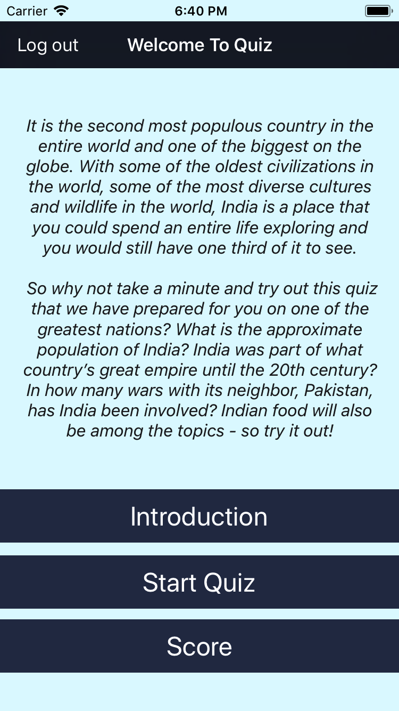
Welcome To Quiz
Press introduction about the quiz by pressing Introduction button.
Press start quiz and enjoy playing the quiz about india.
There will be 10 Random Question having 4 suitable option contains only one true answer.
Real challenge is to select your answer within 10 Seconds otherwise that answer will be marked as unattempted.
All your score will be saved and display on press of score button.

Slide 6
Use of Plist
Read Data From Plist
var format = PropertyListSerialization.PropertyListFormat(rawValue: 0)
var plistData:[String:AnyObject] = [:]
//our data type
let plistPath:String? = Bundle.main.path(forResource: "Questions", ofType: "plist")!
let plistXML = FileManager.default.contents(atPath: plistPath!)!
BackEnd Data Storage

Slide 7
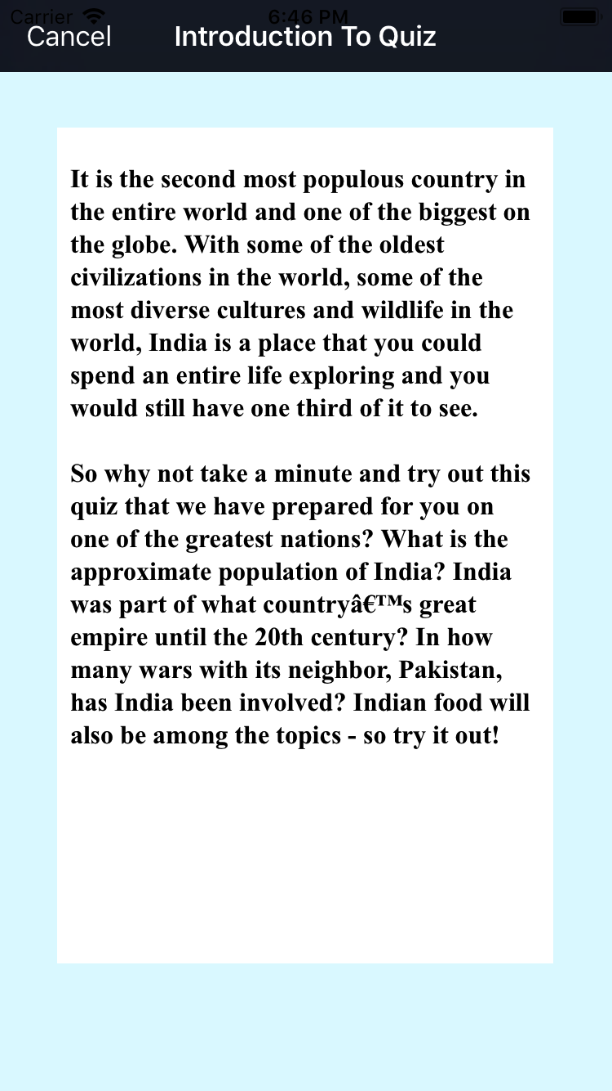
Introduction To Quiz
Web View Controller
let localfilePath = Bundle.main.url(forResource: "Introduction", withExtension: "html")
let myRequest = URLRequest(url: localfilePath!)
webView.loadRequest(myRequest)

Slide 8
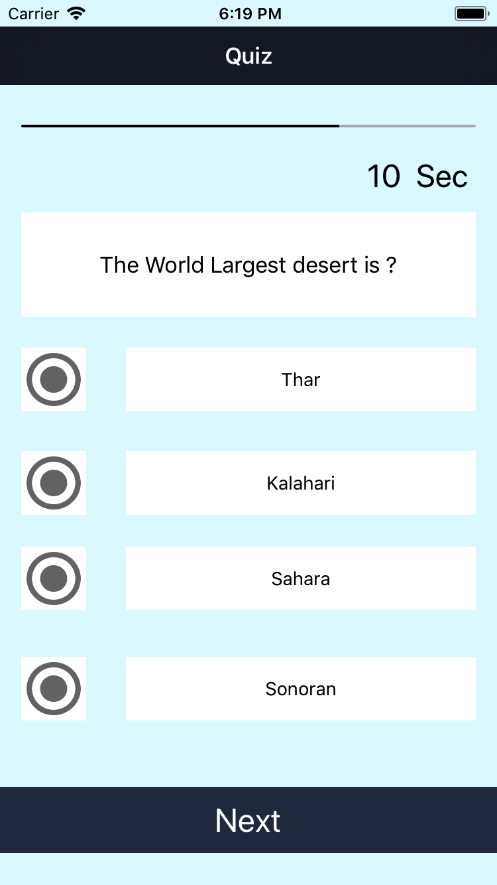
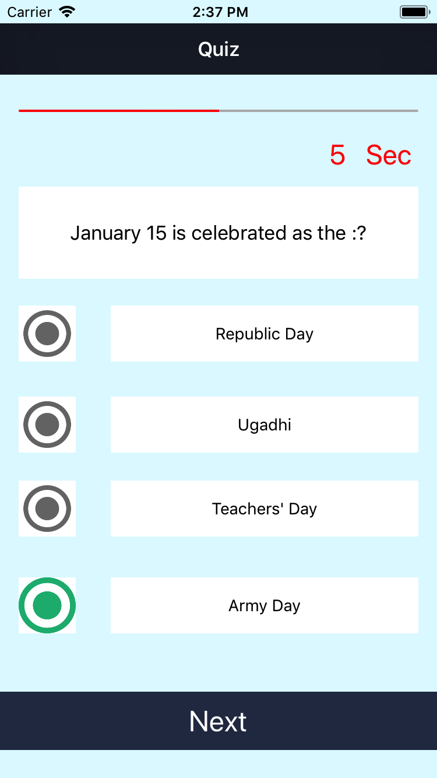
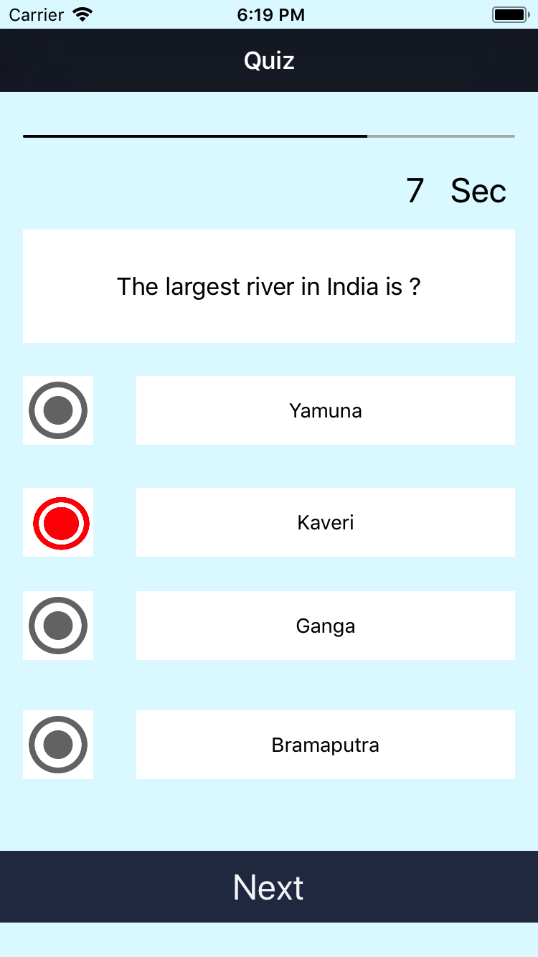

Initial Question
Red Color Indicator
Wrong Answer
User will have 10 seconds to answer the question or skip the question on next click
User will get indicated by turning timer into red color.
User will get indicated about wrong answer on Next press.

Slide 9
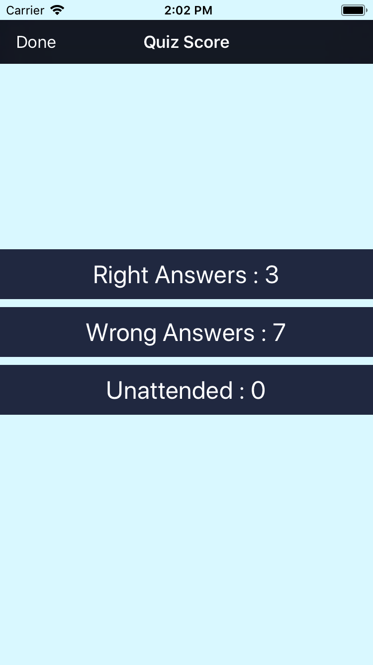
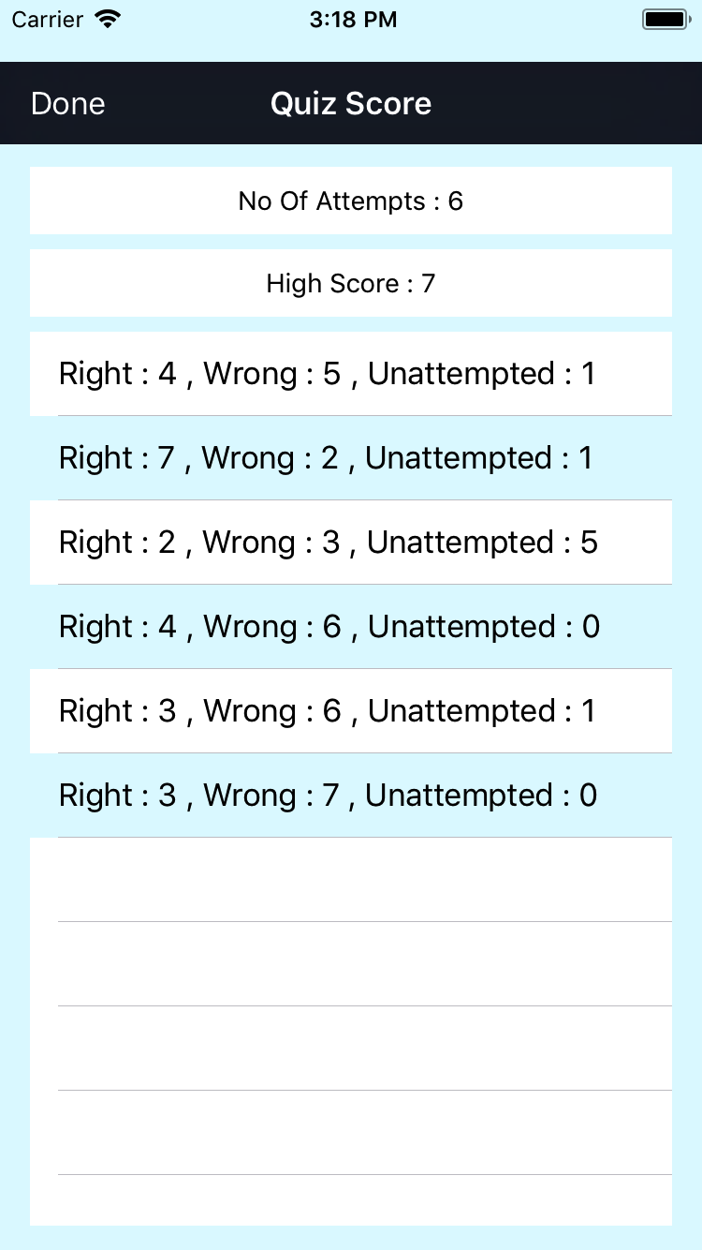
Quiz Score
As per 1st the screenshot user have :
3 correct answers
7 wrong answers
0 Unattended Question
2nd Screenshot shows the result of quiz score attempted by user.
No of attempts
High Score among all quiz
Result of all quiz score

Slide 10
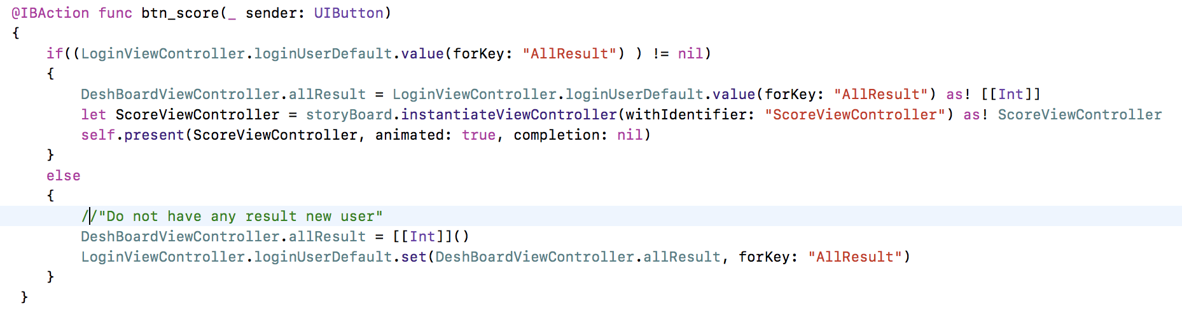
Score Button Click

Slide 11
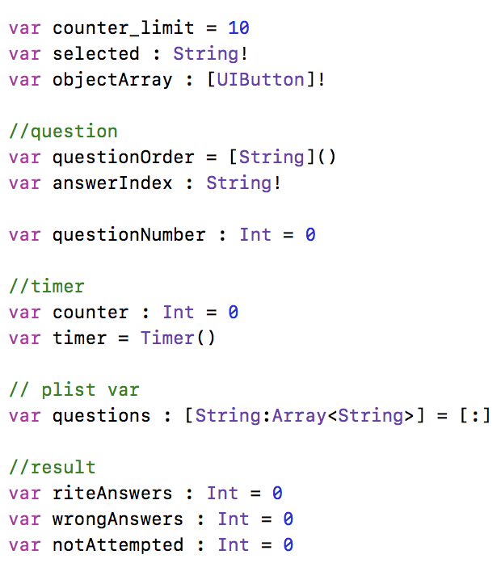
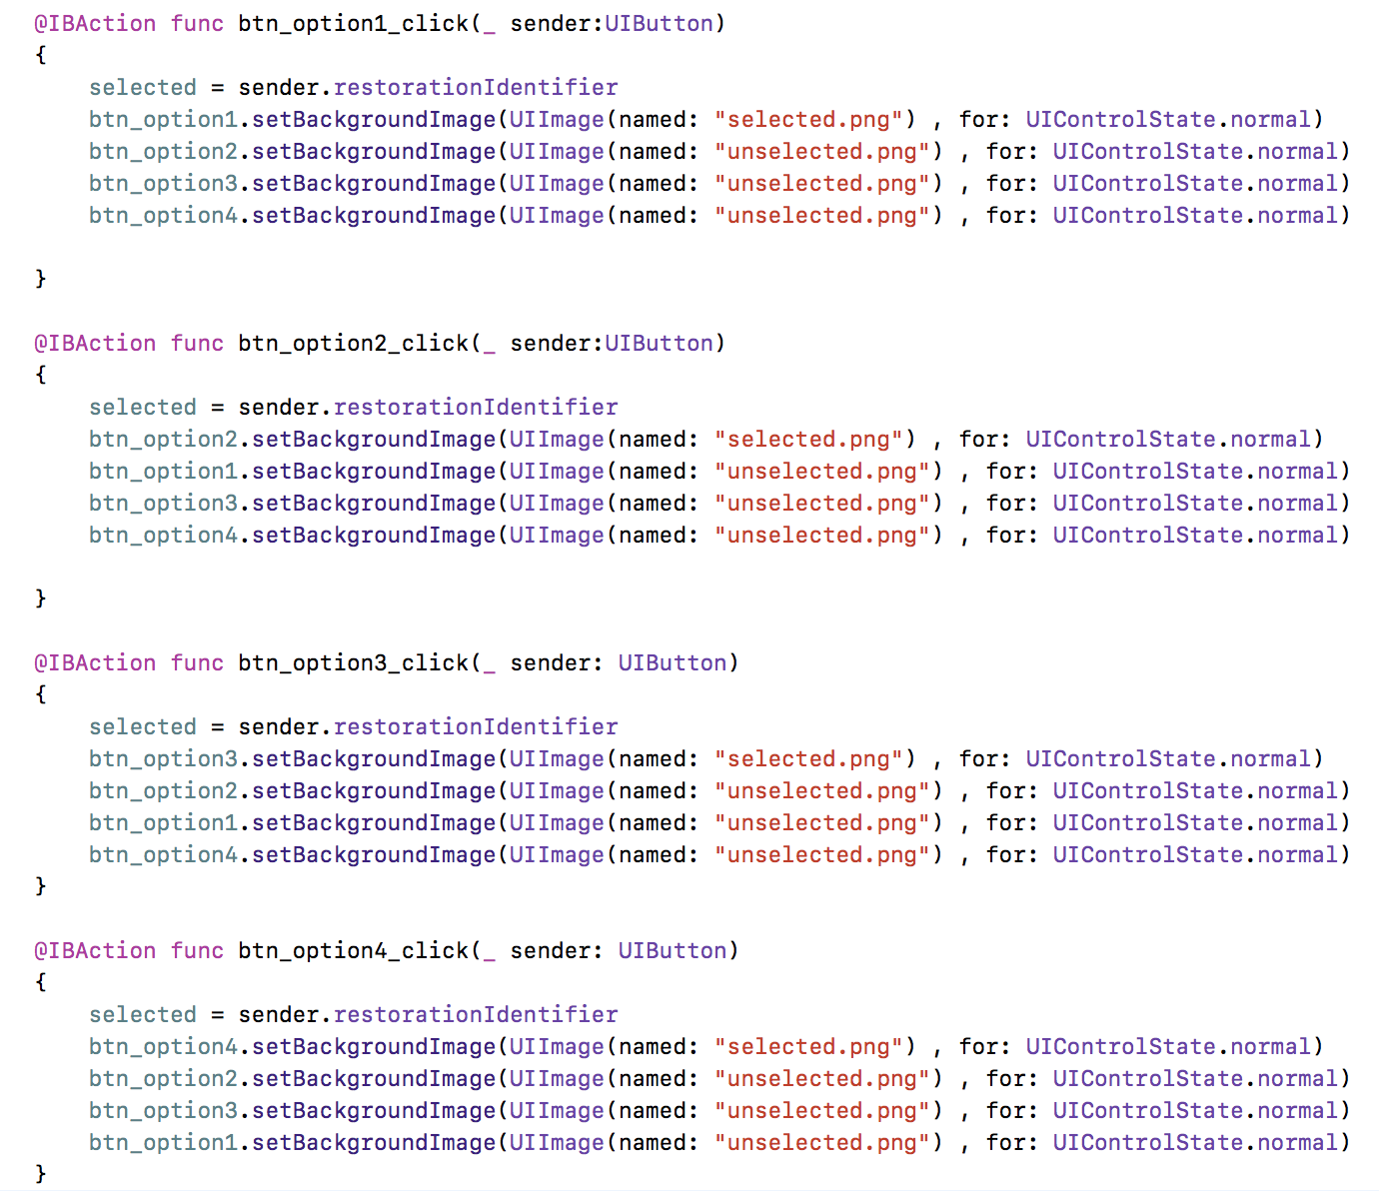
Variables & Radio Button

Slide 12
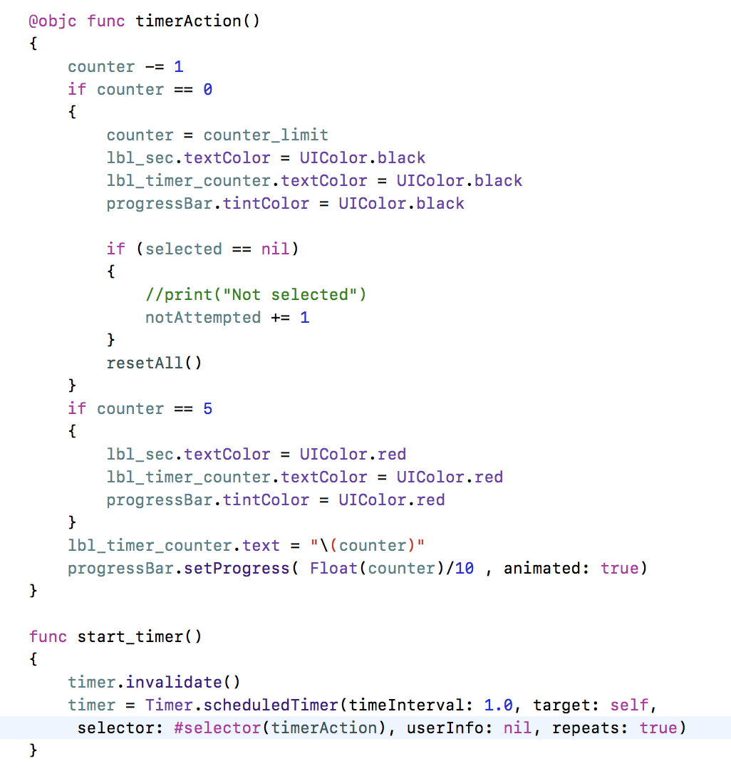
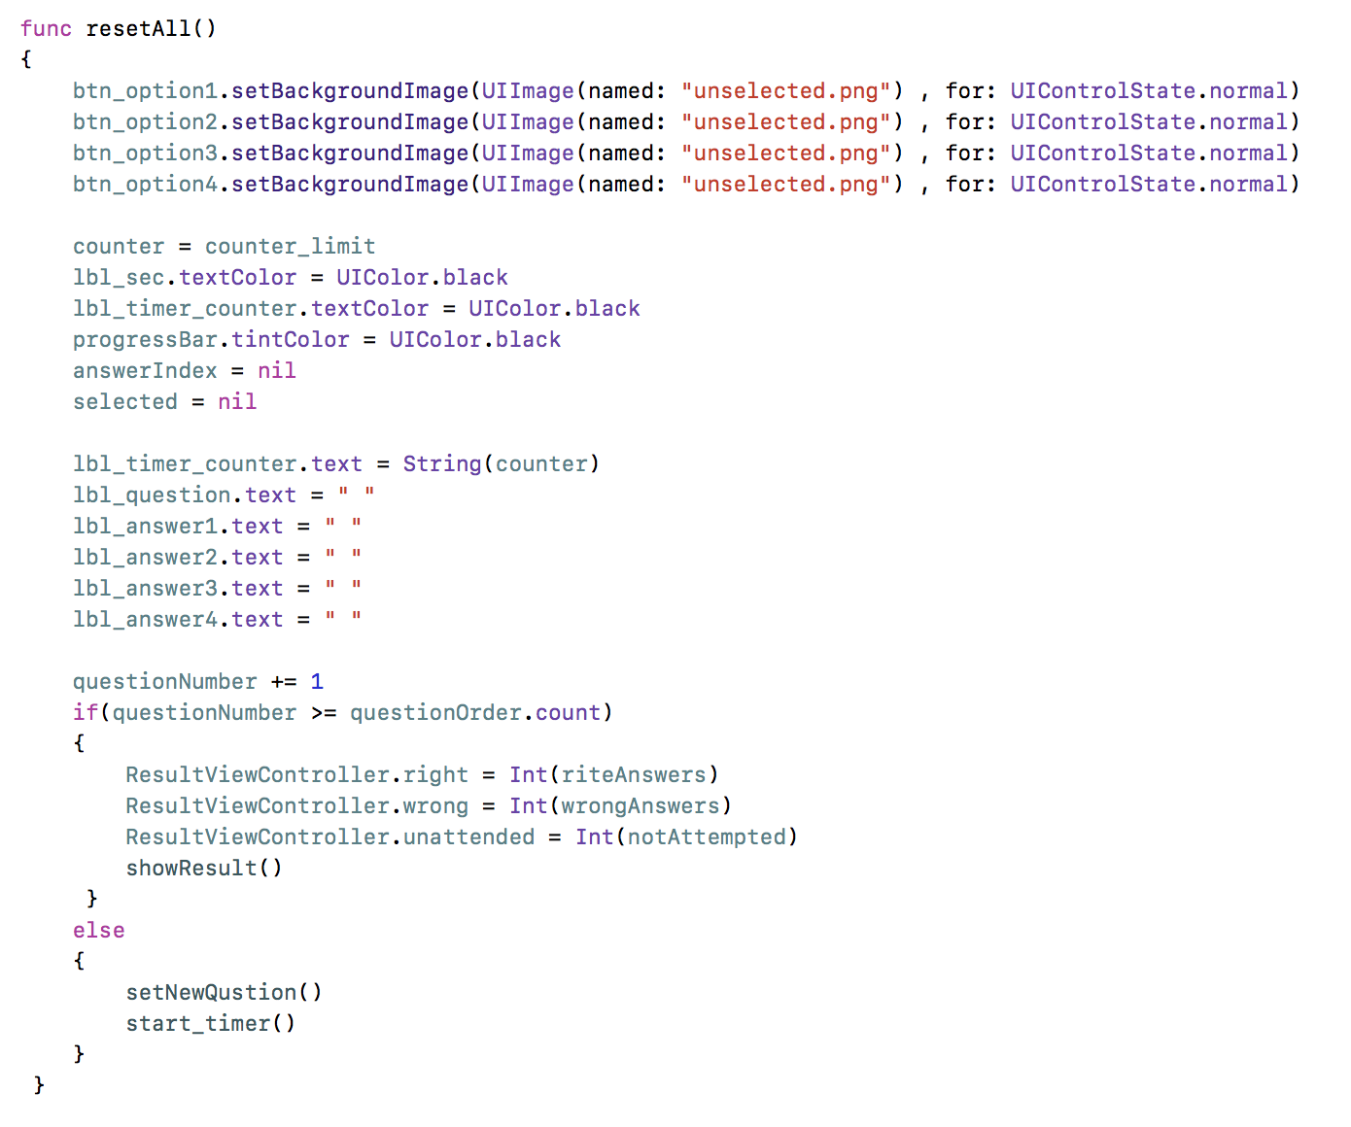
Timer

Slide 13
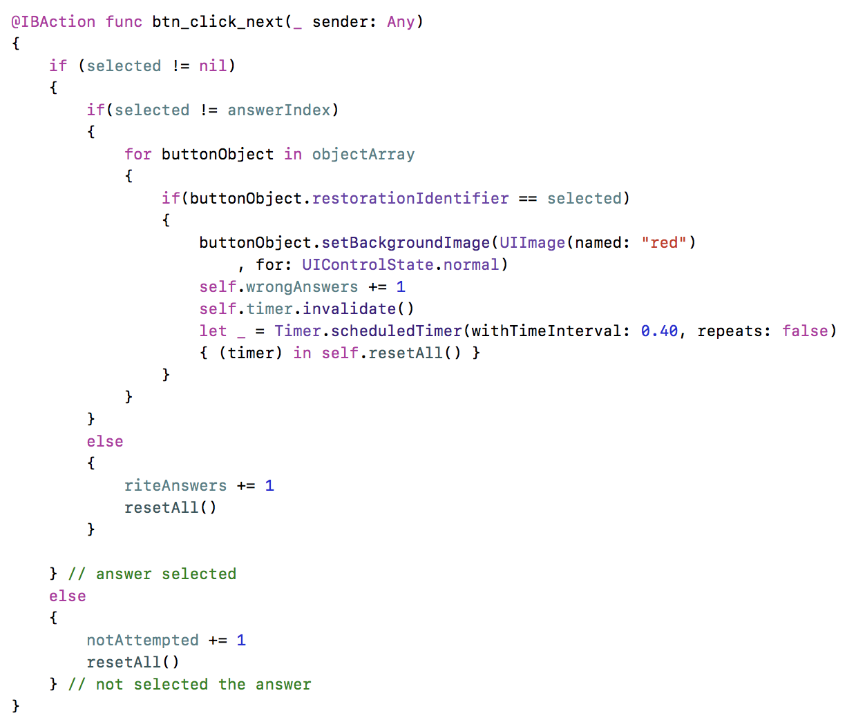
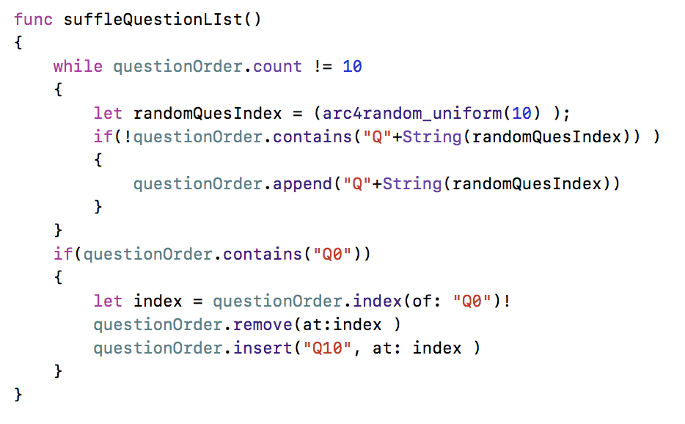
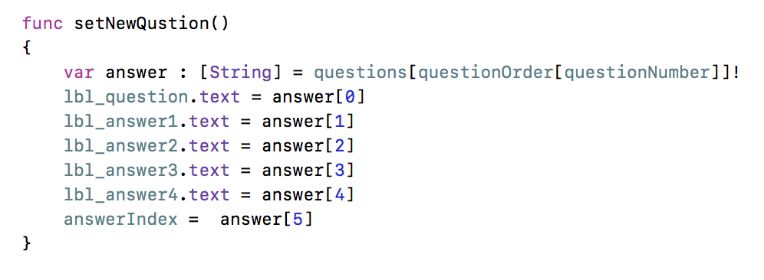
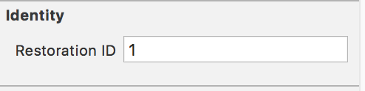
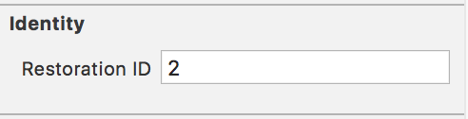
Set Quiz Questions

Slide 14
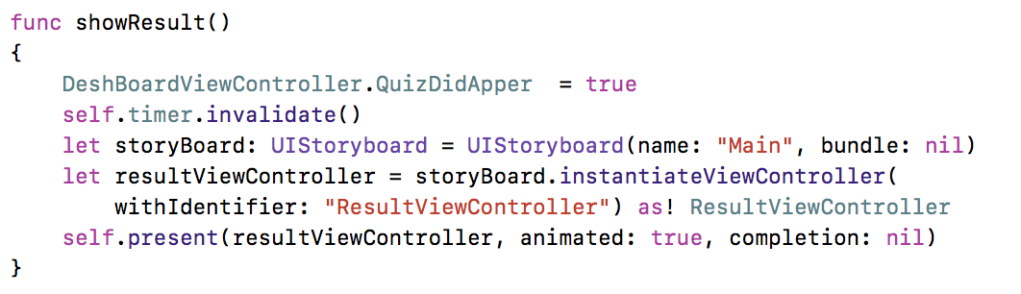
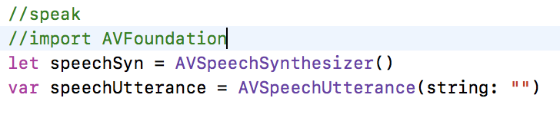
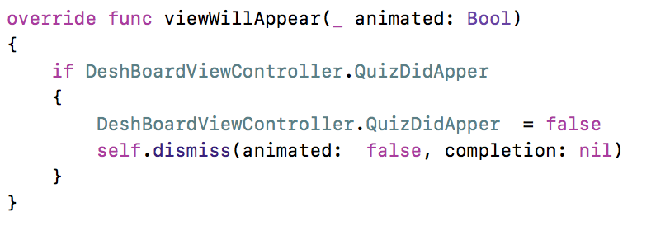
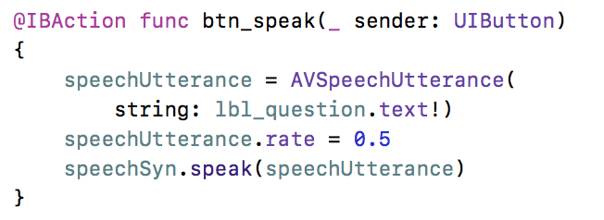

Slide 15
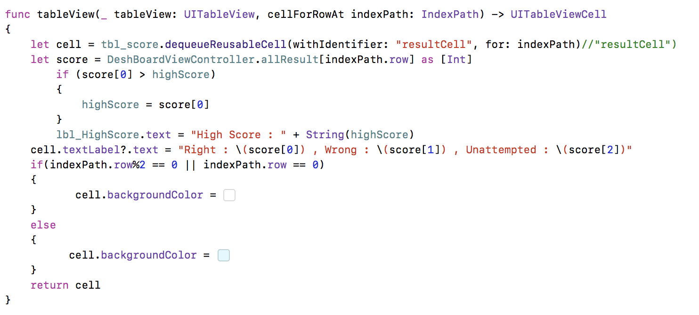
Table View Controller

Slide 16

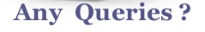
References
https://www.proprofs.com/quiz-school/topic/india
https://developer.apple.com/
https://www.google.ca
For Images

